Slide 1
1. Triple X Game Design Doc

Slide 2
Triple X Game Design Doc (GDD)
Simple number puzzle game
Hacking into a computer lock
Need to find a valid combination of codes
Starts pretty easy, becomes much harder
Wrap in your own story.

Slide 3
Why Triple-X Game?
Learn basics of C++ “syntax”
Learn about variables and constants
Create your own function with an argument
Use #include ready for Unreal
Learn the if and while structures

Slide 4
Why Learn C++ Programming?
All roads lead to C++ in game development
You’ll be learning a superpower
It’s both high-level, and low-level
Join a unique tribe of power users
It’s fun and challenging

Slide 5
What’s Your Story
Try and think of a unique story
If you’re stuck, ask a kid!
Enjoy sharing

Slide 6
the structure of c++ by example
#include statements at top, before used
PlayGameAtDifficulty() before used
Everything inside a function indented
while and if statements extra indented
Colours differentiate types of text.

Slide 7
Explain Our main() Function
Explain our main() function best you can
Don’t worry how much / little you know
The purpose is twofold
Firstly: to be brave, it counts for a lot
Secondly: to record your starting point

Slide 8
2. The Structure Of C++ By Example

Slide 9
int main() { return 0; }

Slide 10
Why int main()?
Every C++ program requires int main()
It is the entry point of a c++ program
Without it, your program will not build!

Slide 11
White Space
Compiler ignores white space!
Don’t be reckless with your code!
Make the effort to make it beautiful!

Slide 12
Your first program!
int main() { return 0; }
It runs and then exits immediately!

Slide 13
White Space
Write your program onto one line
Try compiling
Does it compile?

Slide 14
int main() & White Space
int main() required in every c++ program
Without int main() a c++ program will not run!
We return 0 to signal program has run successfully
Compiler ignores white space
Code style improves readibility!

Slide 15
3. Your First Program

Slide 16

Preprocessor Directive
(Don’t be afraid!)
Instruction to the compiler
Used to include a library before compiling
We want it to be at the start of our file
# represents preprocessor directive in our code

Slide 17
#include <iostream>
Preprocessor Directive
Header File
Instructing the compiler to copy the contents of the iostream header file into our code before the rest of our code is compiled

Slide 18
Include the header file!
Add: #include <iostream> to the first line of your file

Slide 19
4. Hello, World!

Slide 20
std
::
cout
<<
“Hello, World!”
;
Namespace
String
Scope Operator
Cout defined in std namespace

Slide 21
John Doe
John Roe
We can tell the difference in the name!

Slide 22
namespace::myfunction
namespace2::myfunction
Same name!
Namespace avoids the conflict of code being the same name!

Slide 23
TripleX Intro
std::cout << "You are a secret agent breaking into a secure server room";
std::cout << "You need to enter the correct codes to continue...";
Create your own intro messages for your game across two lines of code
Save, Compile & Run program!

Slide 24
Hello World!
# represents a preprocessor directive
<iostream> is a header file
cout is defined in std namespace
“Strings are wrapped in quotation marks”
std::cout << std::endl; for new line

Slide 25
5. Variables

Slide 26
Variables
Used to store data
To use variables in c++ you first must declare them in your code
By declaring a variable you are reserving space in the computer's memory for it

Slide 27
Variable Declaration
int a = 0;
By giving a value to a variable when it is declared, you are initializing it!
Data Type
Variable Name

Slide 28
Variable Declaration
int a = 0;
Initialized
int a;
Uninitialized

Slide 29
Print your the value of your variable
Print your variable onto a new line

Slide 30
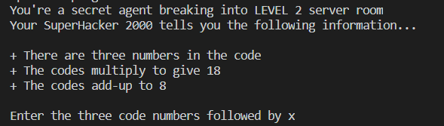
TripleX Codes

Slide 31
Declare two more variables!
Declare an integer named b.
Initialize it
Declare an integer named c.
Initialize it

Slide 32
Arithmetic Operators
Addition Operator = +
Subtraction Operator = -
Multiplication Operator = *
Division Operator = /

Slide 33
Multiply your variables!
Declare the product of a, b & c
Print your product variable on a new line

Slide 34
Variables
You declare variables in code
A variable with a given value is initialized
Declaring a variable = Reserved space in memory
You can add/multiply with arithmetic operators
Print to the terminal like: std::cout << a;

Slide 35
6. const & Assigning Values

Slide 36
Variables
Variables can be changed at runtime
After a variable has been declared, we can assign a new value to it at any point in our code
“A value that is subject to change”

Slide 37
Assigning values to variables
We never want to assign values to variables before the variable has been declared
The compiler will not allow it.
The compiler will not be aware that the variable exists

Slide 38
Try this...
Prefix all your variable declarations with: const
const int a = 4;
Be brave and post your thoughts in the community!
How do you think this affects our code?

Slide 39
Assigning values to variables
We cannot assign a value to a variable before the variable has been declared
The compiler will not be aware that the variable exists if you try assigning to it before it’s declaration
The compiler will not allow this!

Slide 40
const
(Short for constant)
With the const keyword, we signal our intentions to ourselves and to anybody who reads our code:
“We never want this variable to change it’s value after it’s declaration!”
Compiler = best friend! It protects our code!

Slide 41
const & assigning values
(Short for constant)
Assignment Operator =
We can assign values to variables like: a = 4;
Cannot assign before a variable has been declared!
const keyword to mark your variables as constant
The compiler will protect const variables!

Slide 42
7. Statements & Comments

Slide 43
Expression Statements
std::cout << “Hello, World!”;
myvariable = 5;
An expression followed by a semicolon is an expression statement!

Slide 44
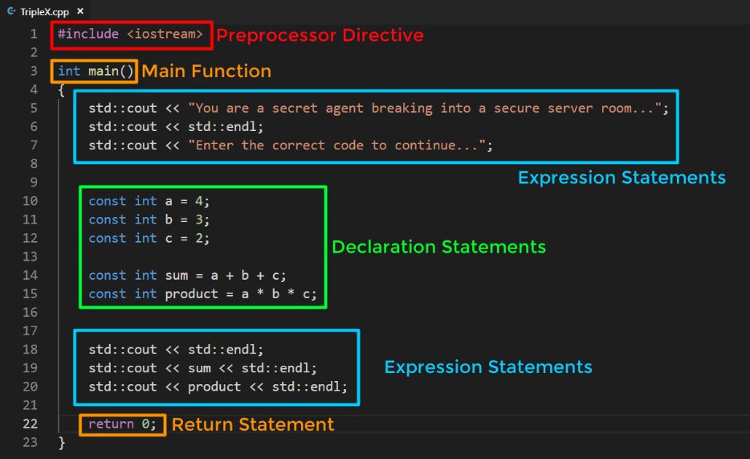
Explain these! Post in the community forum!

Slide 45
Comments
Commenting code can be used to make your code more easily understood by yourself or others!
// This is a single line comment!

Slide 46
Comment your code!
// We use a double forward slash to comment
Add a comment to the start of your main function
What do the first few lines of your main function do in the vision of your game?
Comment wisely!

Slide 47
Statements & Comments
Expression statements:
Expressions that end with a semicolon
Declaration statements:
Statements where we declare ‘something’
Comment like: // This is a single line comment

Slide 48
8. Naming & Self Documenting Code

Slide 49
Your turn!
Print a message about the product
“The codes multiply to give: ”
Take a screenshot of your terminal to showcase your TripleX game in the community!

Slide 50
Variable Naming
Important to give your variables good names!
Must begin with a letter or an underscore
Cannot start with a number!
You must not use a reserved keyword

Slide 51
Keywords
Reserved keywords are to be used by the C++ language only
Over 90 keywords
Examples:
auto | bool | break | case
const | int | friend | return

Slide 52
Self Documenting Code
Makes our code easier to read and understand
If we give a variable a good name, we don’t have to use a comment to explain what it does!

Slide 53
Unreal Coding Standard
Unreal Engine 4 uses an UpperCamelCase naming convention
myVariable
MyVariable
The start of each word is capitalized!
https://docs.unrealengine.com/en-us/Programming/Development/CodingStandard

Slide 54
Rename your variables!
Rename your a, b & c variables:
CodeA, CodeB, CodeC
Rename sum and product:
CodeSum, CodeProduct
Make sure they are initialized correctly!
Follow Unreal Engine 4’s naming convention

Slide 55
Naming & Self Documenting Code
Self document code with good naming!
Must begin with a letter or an underscore
You must not use a reserved keyword
Unreal’s naming convention UpperCamelCase
Right click and “change all occurances” in VS code to rename and replace variable everywhere in file

Slide 56
9. Getting User Input

Slide 57
std::cout << “Hello, World!”;
Insertion Operator
Character Output

Slide 58
std::cin >> PlayerGuess;
Character Input
Extraction Operator
Extract from input stream and assign to variable: PlayerGuess

Slide 59
Store the players guess!
Make use of std::cin
Store the PlayersGuess
Print a message and the value of PlayerGuess
Example: “You entered: 512”

Slide 60
TripleX as a Player
As a player you have to guess a 3 number code
234 will be treated as “two hundred and thirty four”
What if the code was multi digit?
Example: 8 12 24

Slide 61
Answers
Guesses
CodeA
CodeB
CodeC
GuessA
GuessB
GuessC

Slide 62
2 3 4
std::cin >> GuessA;
std::cin >> GuessB;
std::cin >> GuessC;
Your program will only ask for more input when cin is called
IF the input stream is empty!

Slide 63
What’s relevant?
We want the players to enter numbers only
They can enter numbers on seperate lines
Or the same line separated by spaces
We need to add a fix later! Incase anything other than a number gets entered & for replayability

Slide 64
Declare Guess Sum & Products
Declare GuessSum
Initialize it by adding GuessA, GuessB & GuessC
Declare GuessProduct
Initialize it by multiplying GuessA, GuessB & Guess C

Slide 65
Getting User Input
cout = Character Output
Insertion Operator = <<
cin = Character Input
Extraction Operator = >>
Characters like ‘x’ get converted to 0 with integers
Chars like ‘x’ will halt cin from working until reset

Slide 66
10. Using if and else in C++

Slide 67
if statements
if (condition) {
}

Slide 68
if statements
if (condition) {
std::cout << “you win!”;
}

Slide 69
if statements
if (true) {
std::cout << “you win!”;
}

Slide 70
if statements
if (false) {
std::cout << “you win!”;
}

Slide 71
Implement your if statement
Implement an if statement
Enter true as the condition
Add a code block that prints a win message
Play TripleX and see what happens if you win
Play again and see what happens if you lose

Slide 72
if statements
if (condition) {
std::cout << “you win!”;
}

Slide 73
if (GuessSum == CodeSum && GuessProduct == CodeProduct)
{
std::cout << “You win!”;
}
else
{
std::cout << “You lose!”;
}

Slide 74
You win...you lose...
Print a win message if the player enters the correct code
Print a lose game message if the player enters an incorrect code
Share your work so far in the community!

Slide 75
Using if and else in C++
== Equality operator
&& Logical “and” operator
if (condition)
Executes the code block below if condition is met
else
Executes code block below if condition is not met

Slide 76
11. Functions

Slide 77
std::cout << “Hello, World!” << std::endl;
Not the only way to end the line!

Slide 78
Escape sequences
Used to represent different characters within a string
Escape sequences modify the format of a string

Slide 79
He said: “Hello, World!”

Slide 80
std::cout << “He said: ”Hello, World!”;
std::cout << “He said: \“Hello, World!\“”;
Double quote escape sequence

Slide 81
std::cout << “Hello, World!” << std::endl;
std::cout << “Hello, World!\n”;
New line
(Line feed)
Escape sequence

Slide 82
Make use of: \n
Modify your strings to use \n escape sequence
Remove std::endl where necessary

Slide 83
Function
A function is a group of statements that together, performs a task and is given a name
Every C++ program must have at least one function
main()

Slide 84
int main() {
std::cout << “Hello, World!”; return 0; }

Slide 85
Let’s create a function!
Our function will return no value
The name of our function is going to be PlayGame
The function will contain no parameters
The function body will contain the code for playing our game

Slide 86
Your first function!
Return type: void
Name the function PrintIntroduction
PrintIntroduction() at the start of PlayGame()
Create some cool ASCII art to share in the community!

Slide 87
Functions
\n new line escape sequence in strings
A function is a group of statements that is named and performs a task
You must specify the return type of a function
void to return no data
Must be implemented before it is executed!

Slide 88
12. Returning Data From Functions

Slide 89
while loop
while (condition) {
PlayGame();
}
Code block executes repeatedly until the condition is not met

Slide 90
while you’re here...
Pause the lesson and implement a while loop into your main function
Hard code the condition as true
Add a code block for the while loop to execute PlayGame()

Slide 91
Fix the issue!
After PlayGame() in your while loop, add these lines:
std::cin.clear(); // Clears any errors
std::cin.ignore(); // Discards the buffer
Want to discuss in detail? Post in the community and chat with your fellow students!

Slide 92
Has the player completed the level?
Currently PlayGame returns no data
It’s data type is void
We want to return if the player has completed the current level
To do this, we are going to work with Booleans

Slide 93
Boolean
A boolean is a value that is true or false

Slide 94
bool PlayGame()
Change the data type for PlayGame from void to bool
Compile your code and see what happens...

Slide 95
Initializing bLevelComplete
bLevelComplete = PlayGame();
Initialize bLevelComplete with the result of PlayGame

Slide 96
Returning Data From Functions
while loop to execute a code block repeatedly
CTRL + C to exit program
Functions that are not of type void must contain a return statement for all exit paths of the function
bool = true or false value

Slide 97
13. Function Parameters

Slide 98
++LevelDifficulty
LevelDifficulty
1
4
1
= 5

Slide 99
Variable Scope
A variable declared inside a code block has scope
It is local to where it is declared
Cannot be accessed or used outside of its ‘scope’

Slide 100
Create a parameter for PlayGame()
Pause here and create a parameter for PlayGame()
The data type should be int
The parameter should be named Difficulty

Slide 101
Function Parameters
Increment variables like: ++MyVariable;
Think about where you declare your variables
Because of the variables scope!
Function parameters allow us to pass values into it
Passing values is known as passing an argument

Slide 102
14. Comparing Values

Slide 103
Declare a new variable!
Declare a variable for storing the maximum difficulty/level
MaxLevel or MaxDifficulty
Make it a constant by declaring with the keyword const
Initialize it with the amount of levels you want in your game
In scope within our main function
Declare it above the while loop

Slide 104
while loop condition
LevelDifficulty should never become larger than MaxDifficulty
Our while loop condition should check to see if the value of the LevelDifficulty is lower or equal to MaxDifficulty

Slide 105
Comparison operators
Equal to | ==
Not equal to | !=
Greater than | >
Less than | <
Greater than or equal to | >=
Less than or equal to | <=

Slide 106
Update your strings to reflect the game!
When our PlayGame function returns true or false
Update the strings so they reflect:
Moving to the next level if correct code is entered
Retrying the level if the player enters the wrong code
Before we return 0; in main function:
Print a string to the terminal that congratulates the player on completeing the game

Slide 107
Working with random numbers
We are going to initialize our variables with the function that is named: rand()
This function returns a random number

Slide 108
rand()
rand() returns a value in the range 0 and a value that is guaranteed to be atleast 32,767!
We need to have more control over the range!
We need rand() to take our LevelDifficulty variable into account

Slide 109
Comparison Operators
Equal to | ==
Not equal to | !=
Greater than | >
Less than | <
Greater than or equal to | >=
Less than or equal to | <=
Compare values with:
Can be used for conditions
Like in: while and if
Make sure spacing is consistent!
rand() returns a value in the range 0 and 32,767!

Slide 110
15. Generating Random Number Ranges

Slide 111
Modulus Operator
%
Performs a division but returns the remainder!
9 / 4 = 2 r 1
9 % 4 = 1
We can use this to map rand() to our own range

Slide 112
There’s a pattern!
<value> % <modulus>
Maps the <value> between a range of numbers!
The range is between 0 and <modulus> - 1

Slide 113
Modulo Operation
2524 % 10
2524 mapped to a range between 0 - 9
Not 0 - 10! The range is 0 to the modulus - 1
The result is the same as the remainder we would get from dividing 2524 by 10!

Slide 114
Modulo Operation
2524 % 10 = 4
2524 mapped to a range between 0 - 9
Not 0 - 10! The range is 0 to the modulus - 1
The result is the same as the remainder we would get from dividing 2524 by 10!

Slide 115
Mapping rand() to a range
rand() % <modulus>
Maps the random number in the range of 0 and the modulus value (subtracted by 1)

Slide 116
Challenge

Slide 117
Challenge
Limit the range of rand() to initialize variables: CodeA, CodeB & CodeC!

Slide 118
Challenge
Limit the range of rand() to initialize variables: CodeA, CodeB & CodeC!
Play the game!

Slide 119
Modulus Value
rand() % <Modulus>
(Range)
1
0 - 0

Slide 120
Difficulty
rand() % Difficulty
(Range)
1
0 - 0

Slide 121
Difficulty
rand() % Difficulty
(Range)
1
0 - 0
2
0 - 1
3
0 - 2
4
0 - 3
5
0 - 4

Slide 122
Difficulty
rand() % Difficulty
(Range)
rand() % Difficulty + 1
(Range)
1
0
1 - 1
2
0 - 1
1 - 2
3
0 - 2
1 - 3
4
0 - 3
1 - 4
5
0 - 4
1 - 5

Slide 123
Challenge
Initialize your code variables with: rand() % Difficulty
Add 1 to Difficulty to offset the range
Play the game!

Slide 124
rand() % Difficulty + Difficulty
(Range)
Difficulty
1
1
2
2 - 3
3
3 - 5
4
4 - 7
5
5 - 9

Slide 125
Not random yet!
Our game isn’t random yet!
Each time we play it, it produces the same result!
We have one more step...

Slide 126
Seeding rand()
We need to initialize rand() with a different seed
This will produce more random results
The best way to do this is based on your computer’s time
#include <ctime>
At the start of main add this line:
srand(time(NULL));
Creates new random sequence based on the time of day

Slide 127
How far can you get?
Play your game!
What level can you get to?
What level do you find really hard?
Share in the community!

Slide 128
Section 2 Ending
Well done for completing section 2!
You’ve built your first game in C++!
Play an active part in the community!
Help out other students
Share your work

Slide 129
Generating Random Number Ranges
Modulus Operator: %
Performs a division but returns remainder
We can use % to control the range of rand()
+ 1 to offset the range
Well done for completing section 2!
Play an active part in the community!

Slide 130
Unreal C++ Projects for VSCode & VS2019

Slide 131
Creating Unreal C++ Projects
Unreal Engine 4 expects:
Visual Studio 2017 installed if running Windows
Xcode installed if running macOS
By default, Unreal will not allow you to create C++ projects without having these installed

Slide 132
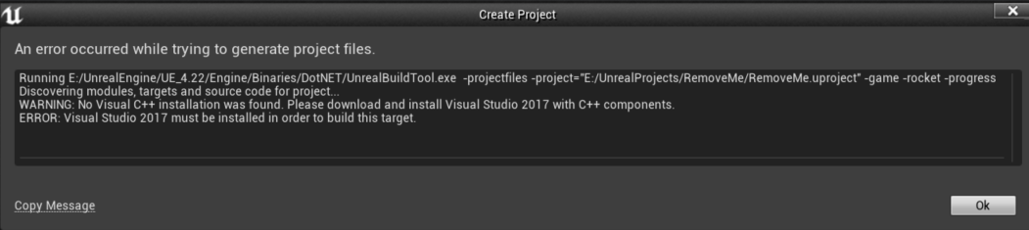
What if we are running VS Code or Visual Studio 2019?

Slide 133
Fix for VS Code & Visual Studio 2019
Launch the Unreal Engine 4 editor
Create a Blueprint Project
Change the source control editor from Unreal’s Editor Preferences

Slide 134
Blueprint projects
Blueprint projects can still be C++ projects!
You just have to add a C++ class to your project

Slide 135
C++ Projects for VSCode & VS2019
To use VSCode or VS2019:
Create a Blueprint Project
Change the source control editor from Unreal’s Editor Preferences
Blueprint projects can still be C++ projects!
You just have to add a C++ class to your project

